Slide 1
High-speed railway development in the
Visegrad countries
Mgr. Ing. Radek Čech, Ph.D.
Director of International Affairs Department
Brussels, 28th March 2022

Slide 2
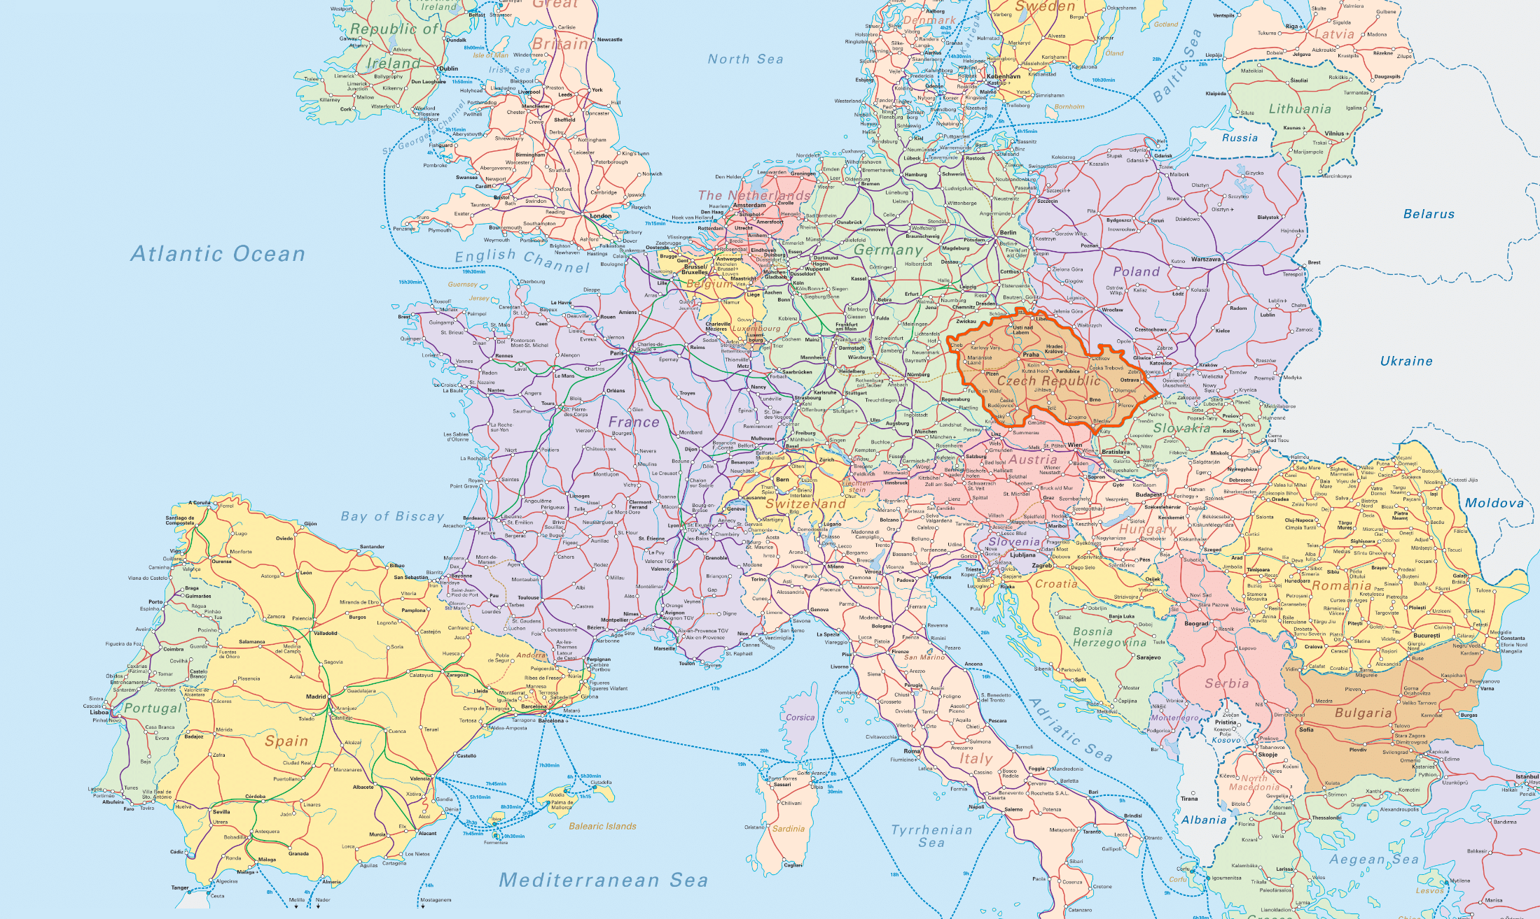
European Railway and Visegrad Group

Slide 3
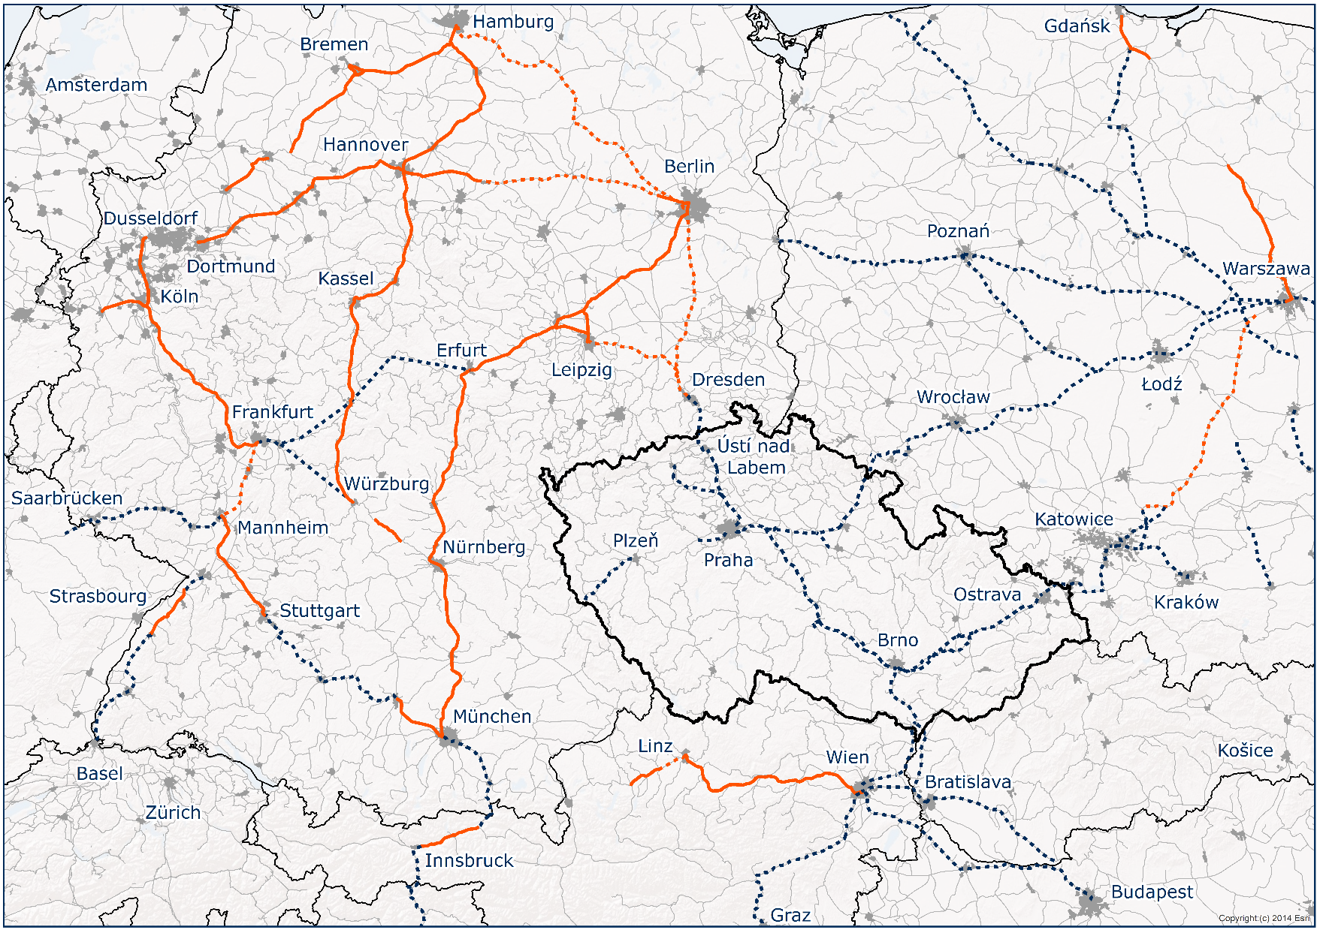
Connecting Europe
HSR line in operation (200+ km/h)
HSR line upgrade
HSR line planned/under construction

Slide 4
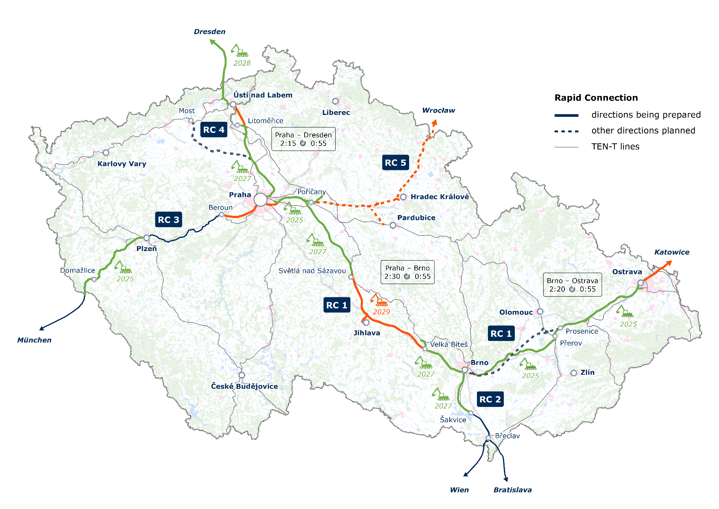
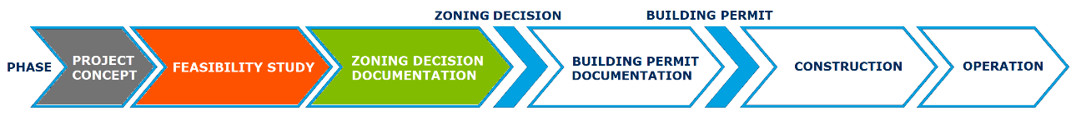
Planned network of Rapid Connections in Czechia
Budapest

Slide 5
Path to HSR implementation in Czechia
2013
2017
Inclusion of HSR into the TEN-T Comprehensive Network system
2018
Government resolution – Rapid Connections development program
since 2019
Memorandum of understanding between Shif2Rail JU and the Ministry of Transport of the Czech Republic
since 2019
Close cooperation between Správa železnic and SNCF
since 2020
Joint planning of the cross-border section Dresden – Praha by Správa železnic and DB NETZ AG
since 2020
Pilot sections project preparation
from 2025
Initiation of inclusion of the HSR backbone into the
TEN-T Core Network system
Gradual launch of constructions

Slide 6





How can small country benefit from HSR?
ECONOMIC
ASPECTS
Infrastructure development
Time savings
Cost savings
Employment increase
SOCIAL
ASPECTS
Job opportunities in regions
Reduction of structural differences
Improvement of life quality
HSR
DEMOGRAPHIC
ASPECTS
Development of regional hubs
Preventing depopulation of regions
Increasing mobility
TRANSPORT
ASPECTS
Increasing speed of transport
Introduction of new rapid services
Increasing security

Slide 7
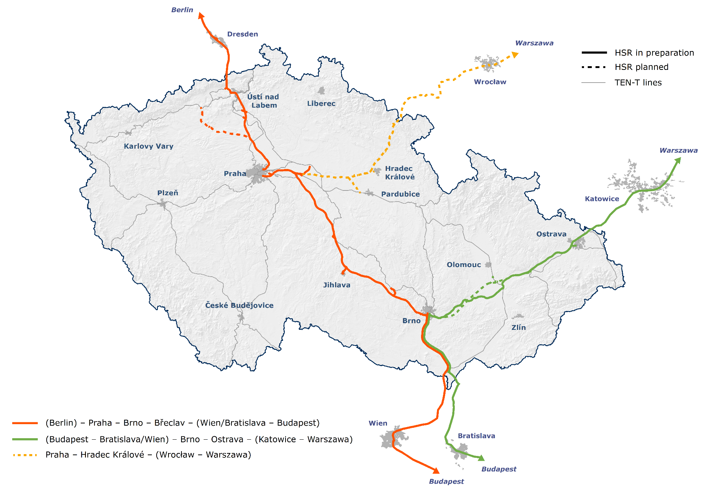
HSR as Crossroad of the Central Europe

Slide 8






What will the Czech HSR bring to Central Europe?
Connectivity of regional cities from Praha usually up to 1 hour
Balancing regional disparities
Significant increase in freight capacity on the existing infrastructure
Improved connections in the west-east and
north-south axis
Crossroad of Europe
The Czech HSR will connect axis Via Vindobona and the Rail Baltica project with southern and southeastern Europe

Slide 9

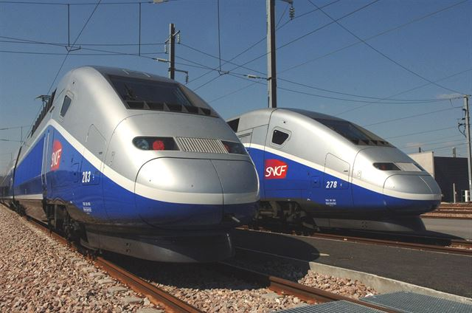
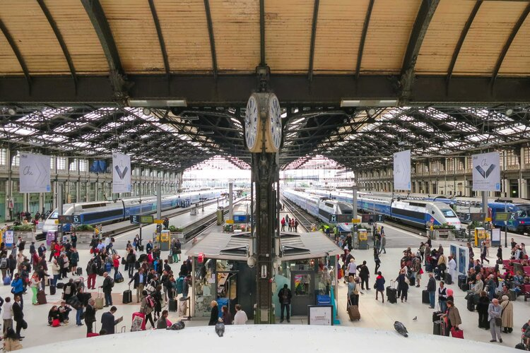





Faster travel in Europe
Line | Now | Target | Trend
Berlin – Wien | 8 h | 4 h | - 4 h
Berlin – Budapest | 11 h | 5:30 h | - 5:30 h
Berlin – Praha | 4 h | 2 h | - 2 h
Warszawa – Wien | 7:30 h | 3,5 h | - 4 h
Praha – Wien | 4 h | 2 h | - 2 h
Praha – Budapest | 6:30 h | 3:30 h | - 3 h

Slide 10




Green Deal
CO₂ emissions produced by transport in EU
30 %
EU commitment to reduce CO₂ transport emissions by 2050 (baseline 1990)
90 %
Carbon & climate neutrality
2050
European Sustainable and Smart Mobility Strategy

Slide 11
HSR – the Key Component of the Sustainable and Smart Mobility Strategy
HSR will be part of the zero-emissions solutions and will be built according to the top standards (Správa železnic cooperates with SNCF Réseau)
Reducing energy intensity and dependence on raw energy materials from Russia
HSR will free up capacity on the conventional lines, hence:
modal-shift of freight and passengers from road to rail will be possible
CO₂ emissions will be reduces significantly as a result
The new HSR are the best opportunity for implementing the smart digital solutions and intelligent transport systems (ERTMS & Digitalization)

Slide 12






HSR as a business opportunity
Opportunity for a single technology market
Regional industry development
Reducing dependence on oil
Space for innovation and research
Employment increase

Slide 13
Thank you for your attention
High-speed railway development in the Visegrad countries
  Mgr. Ing. Radek Čech, Ph.D.
    Director of International Affairs Department
    Cech@spravazeleznic.cz
© Správa železnic, státní organizace
Dlážděná 1003/7, 110 00 Praha 1
spravazeleznic.cz

